Slide 1


The Independent Michael Robertson
Portland State University
CS410: Data Engineering
Bruce Irvin
Genevieve Lalonde
Notes:
Hello.
My name is Michael Robertson, and my team's name is The Independent
This project was created though Portland State University’s Computer Science Course 410: Data Engineering
Which was taught by Bruce Irvin, who was assisted by Genevieve Lalonde.
This project was designed to create a data pipeline to collect, validate, and analyze traffic congestion from breadcrumb data provided by C-TRAN.

Slide 2

C TRAN
What is it?
The public transportation bus provider that
operates from Yacolt, Washington to
Portland, Oregon
Breadcrumbs:
Records of C TRAN movement throughout day
Notes:
C tran is the public transportation bus system that is used from Yacolt Washington, to Portland OR.
C TRAN has 26 bus routes that result in a total of 899 stops.
This transportation system was founded in July of 1981
The breadcrumb data are records of the C tran bus movements while the bus is operational throughout the day.
The bus records its information around every 5 seconds
The information that is saved ranges from the time and date of the record to the location of the bus via GPS coordinates.
The data that was provided by C-TRAN ranges from September of 2020 to October of 2020.

Slide 3


Data Pipeline Structure
Virtual Machine (VM):
Emulation of computer system
Operating Software of VM is Ubuntu
Notes:
This data pipeline was created through a Virtual Machine (known as a VM) using the Google Cloud Platform.
A VM is an emulation of a computer system.
This platform allowed for creating a the VM that was used to design and conduct the data pipeline that was used for this project.
The VM that was created used the operating system known as Ubuntu, which is a version that is used on Linux computer systems

Slide 4

Data Processor
Producer:
API used to publish records to Kafka
Consumer:
API used to process the records
previously published to Kafka
Notes:
Apache Kafka was used as the data processor for this pipeline.
Kafka is a distributed data store optimized for ingesting and processing streaming data in real-time.
The two API’s that were used form Kafka were the Producer and Consumer API.
The producer publishes given records to a Kafka topic
The consumer processes the records that are previously published to the Kafka topic.
It was during the consumer stage that the given data was validated. The validations that occurred were ensuring that the proper information was being collected. If a record did not either have the necessary information or data that would be considered irregular, then that specific record was dismissed. For example, there was one record that stated the bus was moving at a speed of 150 MPH, which obviously was incorrect., therefore the record was discarded
The information that did pass the validations were sent to postgresql data tables.

Slide 5

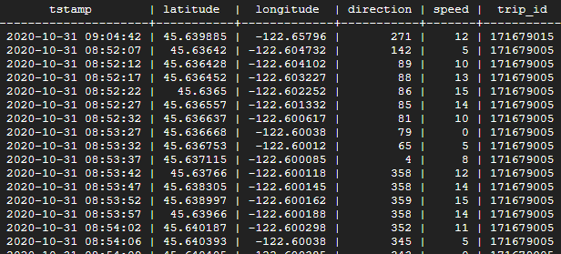
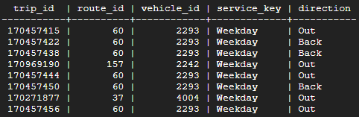
PostgreSQL
What is it?
A database system
Breadcrumb Table
Trip Table
Notes:
POSTGRES is a database system, a system in which data can be inputted into a table in order to organize the data to answer queries or group information.
For this data pipeline, there were two tables that were created. One was named breadcrumb, which listed the date and time, latitude and longitude a the time of the record, the direction it was heading, the speed at which the bus was heading at, and the trip_id of the bus.
The trip table involves the trip_id that is connected to the breadcrumb table, the route id that the trip_id was associated with, the vehicle_id that was assigned to the bus that was being recorded, whether it was a weekday or which weekend day it was, and whether it was going to its starting point, or starting from there.

Slide 6
Summary of Data
 | Weekdays | Saturday | Sunday
Average # of records | 375,000 | 180,200 | 134,200
Average # of accepted records | 360,000 | 175,000 | 132,750
Notes:
Throughout the data collection process, there was a pattern that was discovered. As expected, there are more breadcrumb data that was recorded during the weekdays, because there are more stops on the Weekday schedule for C TRAN.
Saturdays have nearly half of what a week days’s average count would be. Sundays had the least number of records. When the validations occurred, there were often many records that were not accepted. There were usually more rejected records on the weekdays due to there being more records having to be analyzed.

Slide 7
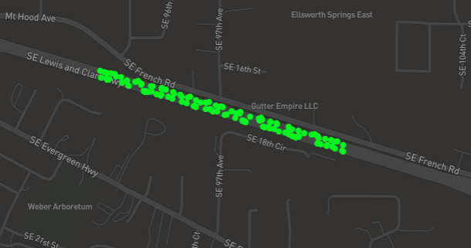
Visual A
SELECT longitude, latitude, speed FROM breadcrumb WHERE DATE(tstamp) = '2020-10-28' AND (EXTRACT(hour FROM tstamp) >= 12 AND EXTRACT(hour FROM tstamp) <= 20) AND (longitude >= -122.576979 AND longitude <= -122.569501) AND (latitude >= 45.606989 AND latitude <= 45.610794)
Portion of Highway 14 On Wednesday 28OCT2020
Notes:
This a visualization of a portion of the breadcrumb data that was collected. In the image shown, the breadcrumb data shows a portion of Highway 14 and the records that correspond to this section on Wednesday the 28th 2020 from 12pm to 8pm. The green dots represent both the location and the speed at which the buses were traveling, in which the bus was moving at around the same speed the entire time that it was within this frame.

Slide 8
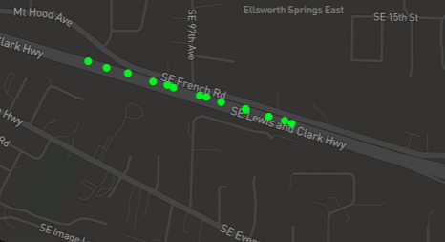
Visual B
SELECT longitude, latitude, speed FROM breadcrumb WHERE DATE(tstamp) = '2020-10-25' AND (EXTRACT(hour FROM tstamp) >= 12 AND EXTRACT(hour FROM tstamp) <= 20) AND (longitude >= -122.576979 AND longitude <= -122.569501) AND (latitude >= 45.606989 AND latitude <= 45.610794)
Portion of Highway 14 On Sunday 25OCT2020
Notes:
This is a visualization of the same location but on a Sunday, specifically OCTOBER 25th 2020, still at 12PM to 8PM.

Slide 9
Sunday
25OCT2020
Wednesday
28OCT2020
Notes:
Here are the two visuals next to each other.
The Sunday visual is significanly less populated compared to the Wednesday due to there being less stops that would occur on a Sunday, compared to that of a week day.

Slide 10
Difficulties
Validations
Connecting to PostgreSQL
New Tools
Notes:
There were some problems that arose during the process of making this data pipeline. Some were small things like not being enough validations. This specific problem led to some data being inserted that should have not been. Once more validations were created, the accepted records were better aligned towhat they should represent.
Another problem was originally connecting to the Postgres tables. This was a problem because if the day’s accepted records were very large, then it would take a longer portion of time to insert the data.
But if there was a problem while this was occurring then all the time for waiting fot the data to be inserted just to crash midway, would have led to wasted time and having to remove the partioally uploaded data to eliminate duplicate data.
The last major difficulty was the new tools, to me, that were to be used for this pipeline. Due to it being new to me, it took a learning curve to successfully both understand and implement it into the program. After a little trial and error, however, the tools were correctly utilized and worked as they were designed.

Slide 11



Thank you
Notes:
I would like to take this time to say thank you to C Tran for providing the data that was used for this. I would also like to thank you both Bruce and Genevieve for their help and guidance with this project as well. Thank you

